Slide 1
NCIA Imaging Architecture

Slide 2
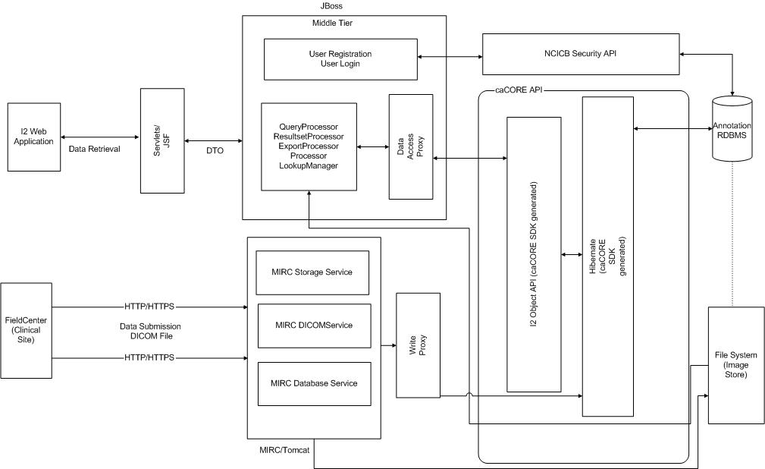

Slide 3
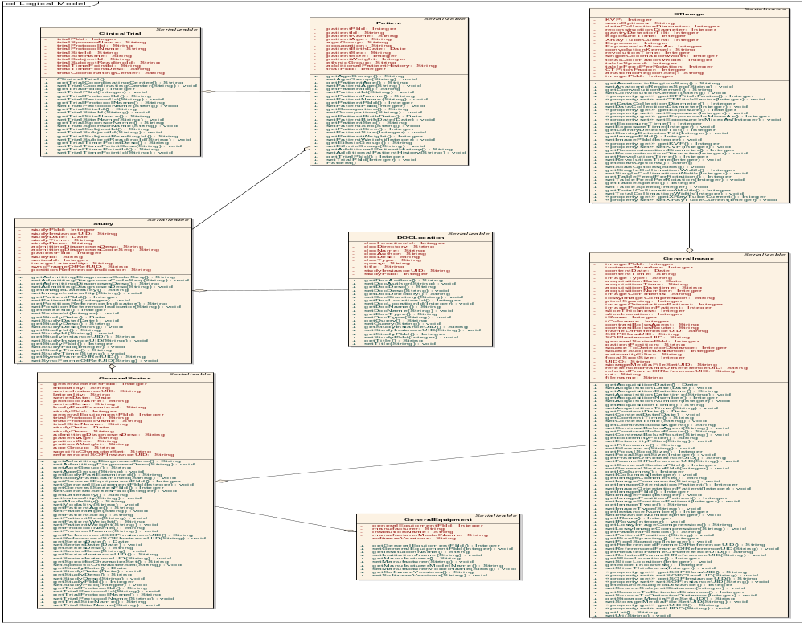

Slide 4
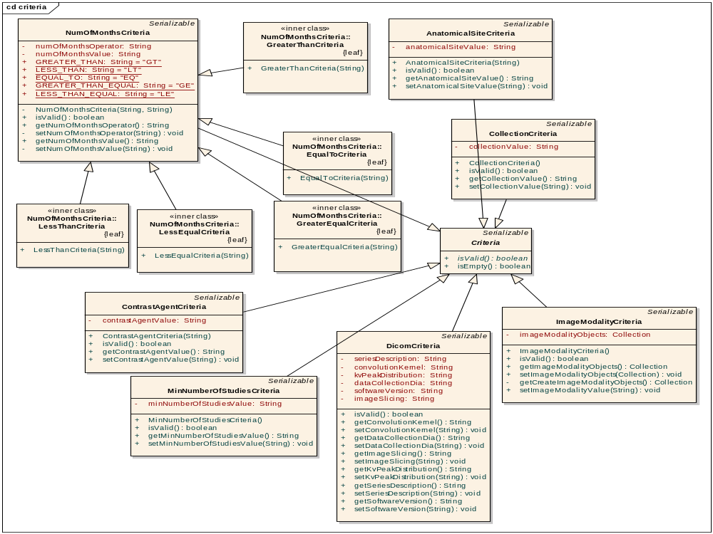

Slide 5
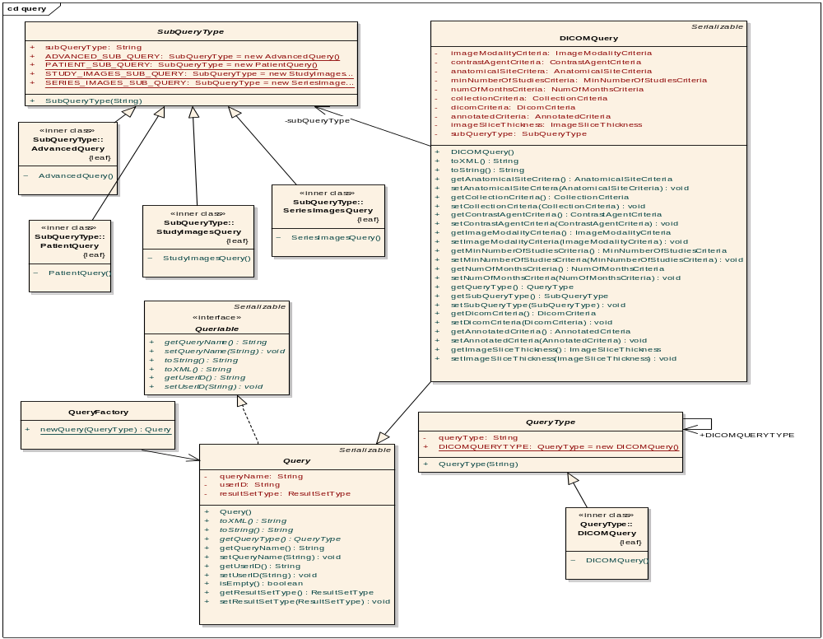

Slide 6
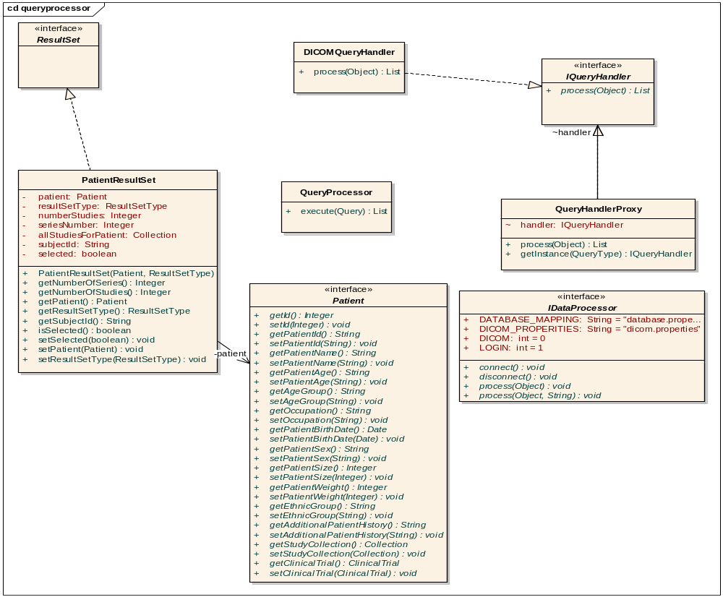

Slide 7
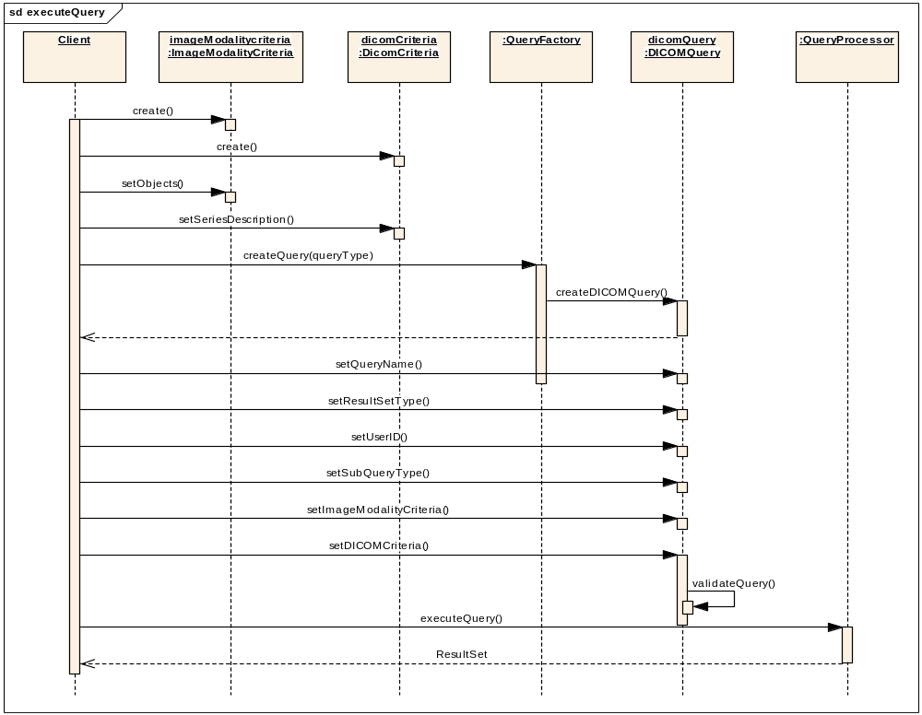

Slide 8
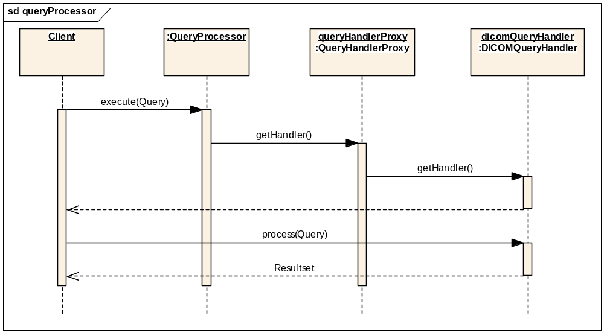

Slide 9
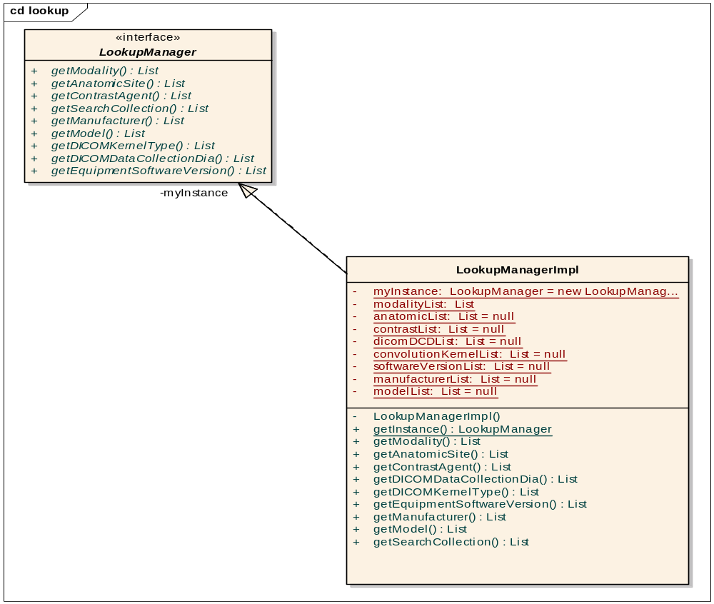

Slide 10
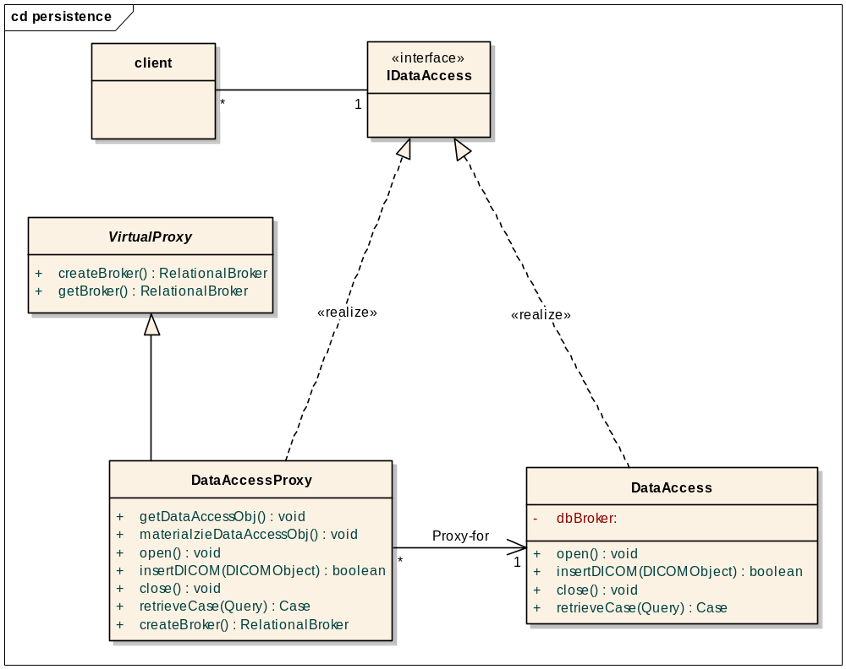

Slide 11
Performance
Based on NCIA Pilot
  Study = 200 Images (average) x 0.5 MB (each) = 100 MB / study
  Study (compressed 40%) = 40 MB / Study
  Time for download (T1 line) = 4/5 minutes per study (for 40 MB)
  Dial up will take longer (no metrics)
  Longer downloads could impact performance for other users online
  Send files to FTP location for files > 1 GB
  For files > 50 GB, send via DVD.
Based on Present version on Dev
    400 MB file takes 55 secs to Zip and 25 seconds to download
    2370 MB (2.3 GB) file takes 340 secs (5 minutes) to Zip and 120 secs (2 minutes ) to download

